Slide 1
XRayTracing Script - Presentation
Subtitle
Guillaume Fontaine, 10/09/24
M-ID 128379

Slide 2
Table of content
Context & objective
Description
Performances
Live Demo
Conclusion
References

Slide 3
Context & objective
In radiation processing, computing the dose in a product processed with X-rays is necessary in many circumstances (DUR, throughput, impact of geometry and source, …)
Such computation accurate using Monte Carlo simulations. But requiring access to a Monte Carlo code, specific knowledge and time consuming
To cope with such limitations, Arnaud Pierard developed a “throughput tool” that allows estimating rapidly the dose in a product [1]. However, although very useful, this tool suffers from a limited accuracy.
To address this limitation, in 2022 D. Prieels developed XrayTracing.py, a prototype of ray-tracing algorithm that computes the dose in a product with a relatively good accuracy [2, 3].
In 2024, G. Fontaine developed an improved version of XrayTracing.py. The improvement includes both a higher accuracy and an automatization of the calculation.
The objective of this presentation is to present this new version of XrayTracing.py, to explain how to use it and to present its performances.

Slide 4
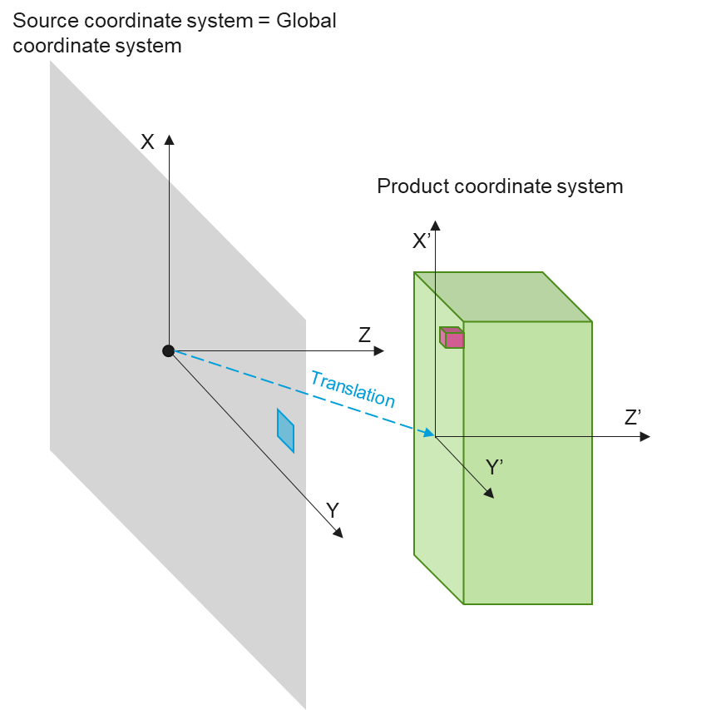
Context & objective
XRayTracing is a python script that computes the dose in a rectangular parallelepiped of uniform density that would be processed with a X-ray beam [1].
Practically, XRayTracing computes the dose from an extended X-ray source using a ray-tracing algorithm. This algorithm relies on a ‘kernel’ that provide the depth dose curve for any angle of emission.
The purpose of this report is to present how such kernels were constructed.

Slide 5
Table of content
Context & objective
Method
Results
How to create new kernels?
References

Slide 6
Method
Kernels are built thanks to depth dose curves computed by Monte Carlo simulations using RayXpert.
In practice, the construction of a kernel includes two major steps:
The computation of depth dose curves with RayXpert for several angles of emission
The interpolation of the results to create the kernel
As of today, three kernels are available:
Angle2Dose [2]
RBF
Linear Interpolation
As the development of the first kernel was already reported [2], only the development of the two new kernels is explained in this report.

Slide 7
Table of content
Context & objective
Method
Step 1: Computation of depth dose curves with RayXpert
Step 2: Kernel creation
Results
How to create new kernels?
References

Slide 8
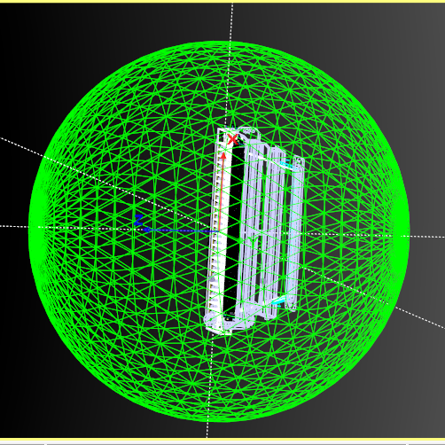
Method
Unlike angle2dose, the depth dose curves for the new kernels were created using a spherical shell (instead of a cubic bunker).
The shell is made of cellulose, 0.36 g/cm³. The inner radius is 3 m and the outer radius is 6 m.
In order to properly take into account the attenuation of the X-rays in the structural elements of the X-ray horn, the simulation uses the CAD model of the 220 cm X-ray horn.
As the conversion of electron to photon is a relatively inefficient process, the simulation is divided in two parts:
Conversion e-γ and creation a particle storage file
Use of the particle storage file to compute the depth doses in the spherical shell.

Slide 9
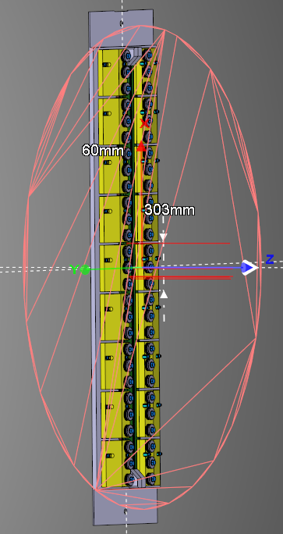
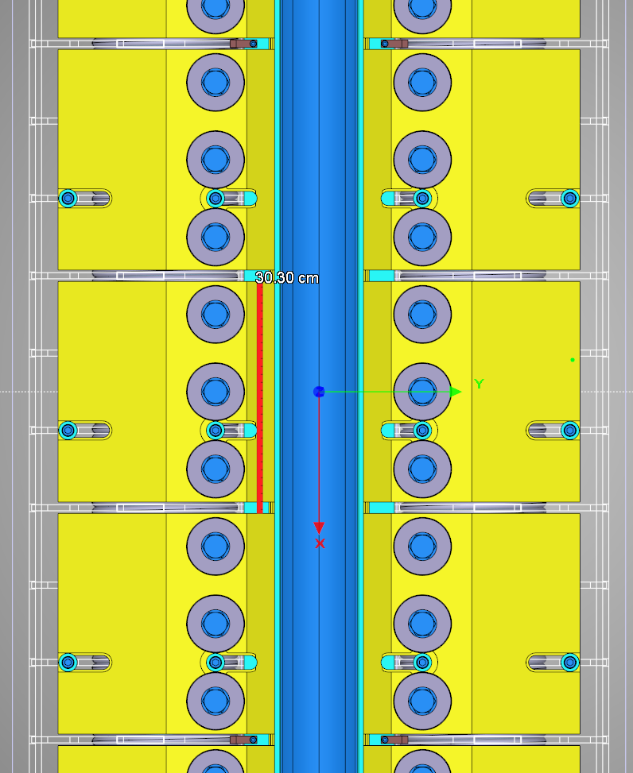
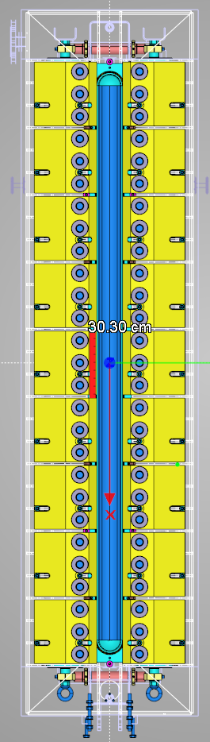
Part A: Conversion e-g and creation a particle storage file (1)
The X-rays are created by using a monoenergetic, parallel E-beam source of 7 MeV, 1 mA. Its size is 30.3 x 6 cm² [2].
The X-rays are stored in a large disk, 3 m in diameter, located at the exit of the horn.
6 x 30.3 cm²

Slide 10
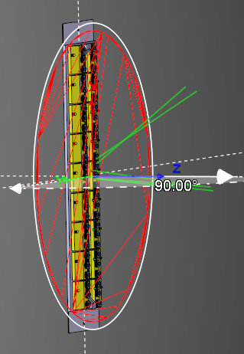
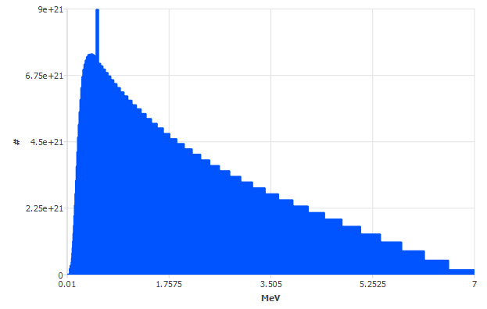
Part A: Conversion e-g and creation a particle storage file (2)
The generated X-ray spectrum is given here below (100 groups, logarithmic scale). The 511 keV peak is clearly visible.

Slide 11
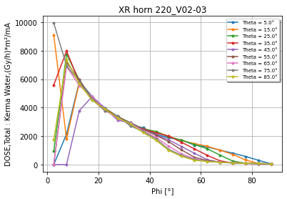
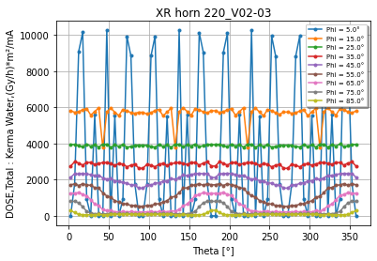
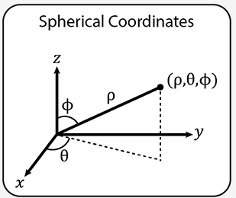
Part B: Computation of depth dose curves in the shell (1)
To compute the depth dose curves, many dosimeters are placed in the shell. The geometry and the positioning of such dosimeters were chosen to take into account the following constraints:
The dosimeters should be large enough to optimize the computation time
The numbers of dosimeters must be limited to avoid excessive time to create the model
The discretization in Z must be sufficient to correctly map the dose curves
The discretization in phi and theta must be good enough to reflect the angular emission of the X-rays. The dependency in (phi, theta) was already studied for the creation of angle2dose [2] – see results here below.

Slide 12
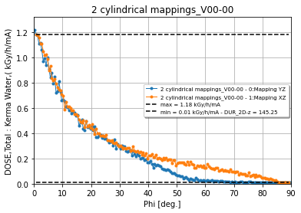
Part B: Computation of depth dose curves in the shell (2)
To fine tune the necessary discretization in phi and theta, the Kerma water was computed in two annulus positioned in the first layer the shell.
As already observed in [2], the results show the steep gradient between Phi = 0 and 20°. They also show the collimation due the Aluminum flanges starting at phi > 30°.

Slide 13
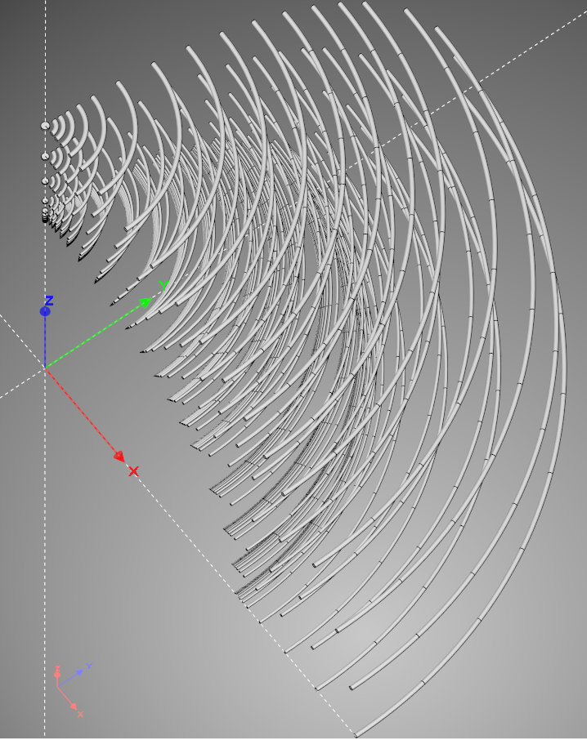
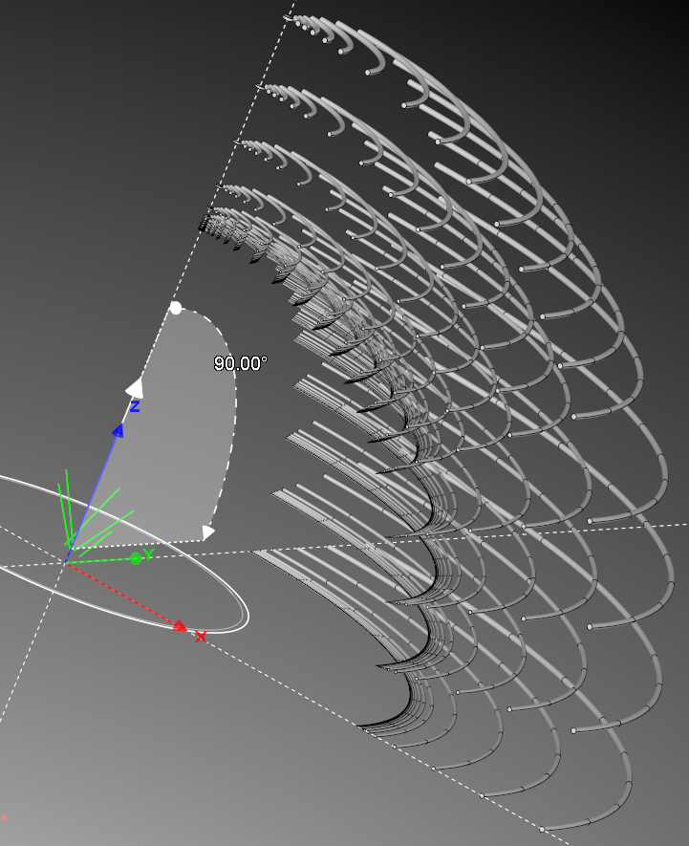
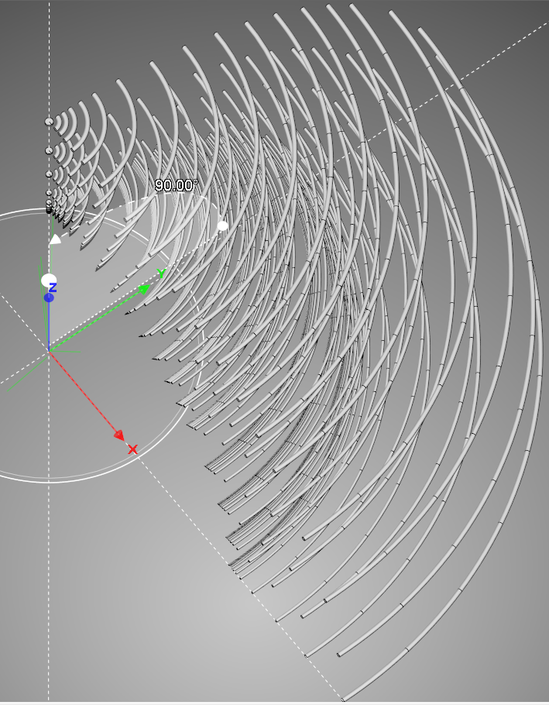
Part B: Computation of depth dose curves in the shell (3)

Slide 14
Table of content
Context & objective
Method
Step 1: Computation of depth dose curves with RayXpert
Step 2: Kernel creation
Results
How to create new kernels?
References

Slide 15
Kernel Creation
Two new methods : Linear and RBF
Methods creation based on data simulated in RayXpert
Methods explanation :
RayXpert dose data points for many (theta,phi,x) 3D coordinates (x=depth*density [g/cm²])
Interpolation :
Linear Method :
Creation of linear interpolator of 3D data points with any new point (theta’,phi’,x’) using ‘LinearNDInterpolator’ from scipy.
Precomputation of interpolation for a well refine grid of (theta,phi,x) coordinates saved in .pkl format
RBF Method :
Fitting depth dose curves for all (theta,phi) simulated data with parameters x0, a, d and e
Depth curve :
If x >= x0 : Dose(x) = d*exp(-e*x)
If x < x0 : Dose(x) = ax²+bx+c with b and c defined such that Dose(x) and its derivative are continuous
Interpolation of x0, a, d and e respectively for all (theta,phi) coordinates using RBF (Radial Basis Function) technique
save 4 RBF functions in .pkl format
Saving and Loading RBF functions or precomputed data for dose computation in XRayTracing

Slide 16
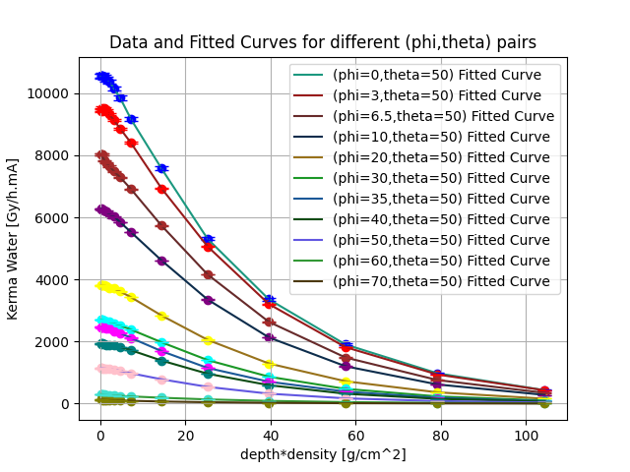
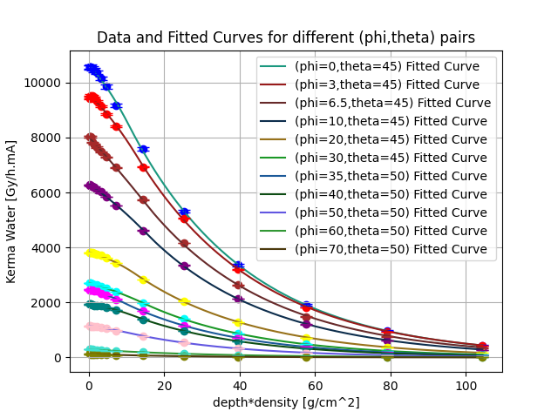
Kernel Creation
Possibility of visualizing depth dose curves for both methods after creation
Depth dose curves for different phi values : Both methods highly relevant
Linear Method
RBF Method

Slide 17
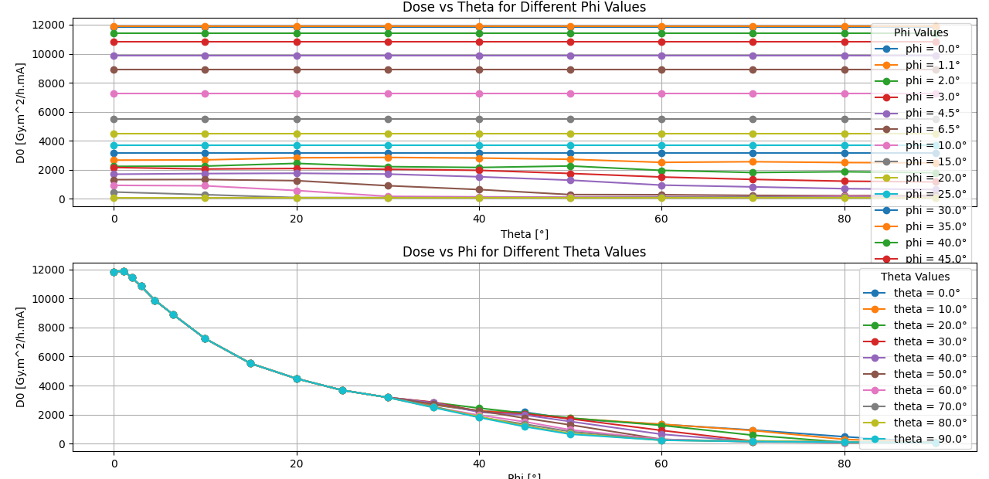
Kernel Creation
Possibility of visualizing RBF parameters like ‘d’ (also named ‘D0’)
D0 curves when varying theta and phi : tendencies similar to Angle2Dose ones
RBF Method
17

Slide 18
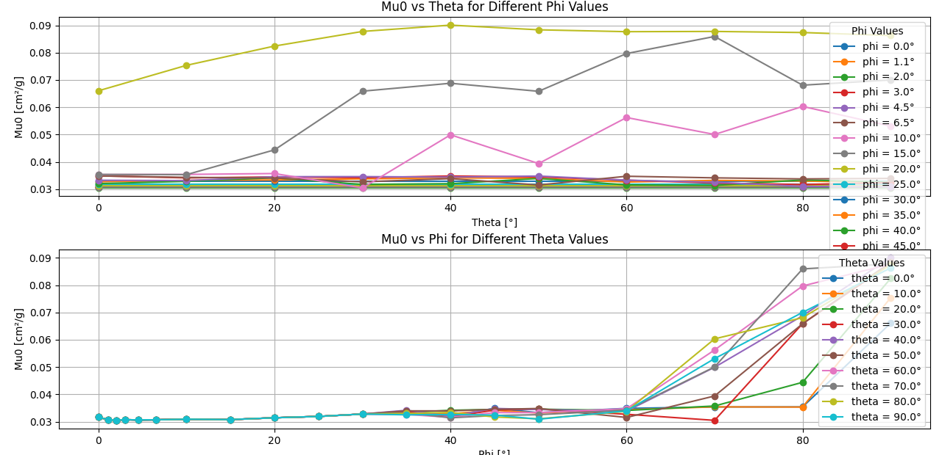
Kernel Creation
Possibility of visualizing RBF parameters like ‘e’ (also named ‘Mu0’)
Mu0 curves when varying theta and phi : similar to Angle2Dose for small phi’s
RBF Method
18

Slide 19
Table of content
Context & objective
Method
Results
How to create new kernels?
References

Slide 20
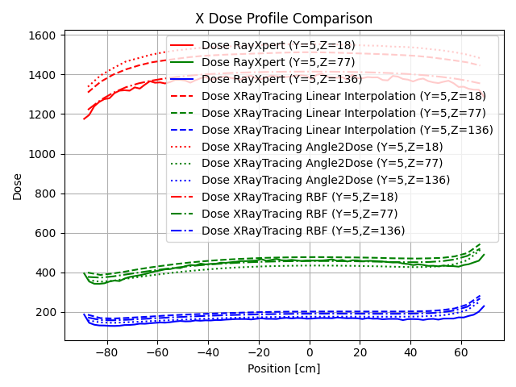
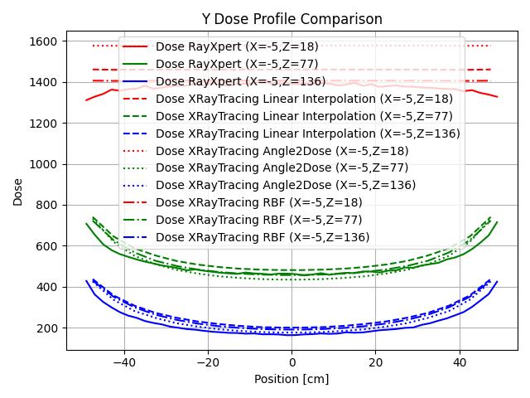
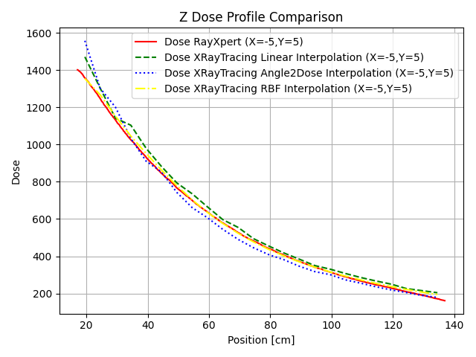
Results Single Side
XRayTracing Single Side Results on Citrus_V03 set up for different methods
Comparison dose results between methods with RayXpert simulated data
All methods relatively close to RayXpert results
RBF method seems the best for all X, Y and Z profiles and also the smoothest
We see Angle2Dose over-predict the dose for shallow depths

Slide 21
Extra Results
For more results, check the validation report for XRayTracing …

Slide 22
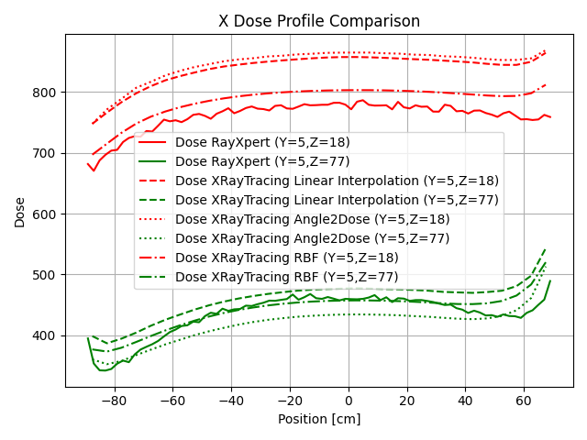
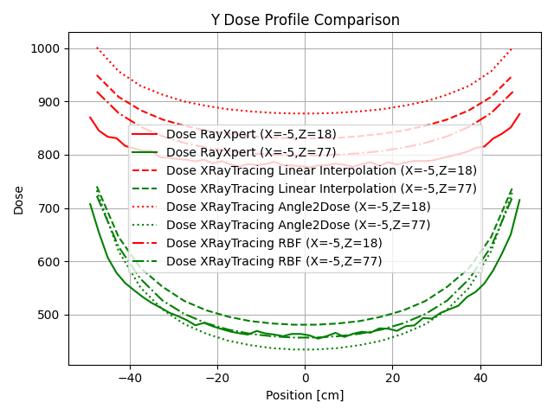
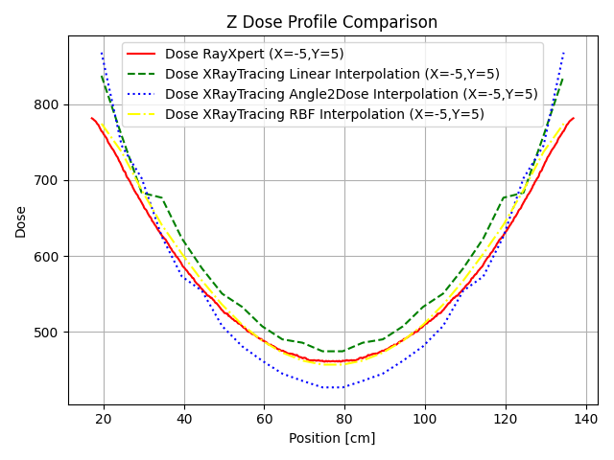
Results Double Side
XRayTracing Double Side Results on Citrus_V03 set up for different methods
Comparison dose results between methods with RayXpert simulated data
All methods still close to RayXpert results except for front plane dose (Z=18 -> 1cm depth)
RBF method is the overall best by far for all X, Y and Z profiles and the smoothest
We can compare the relative errors on next slide

Slide 23
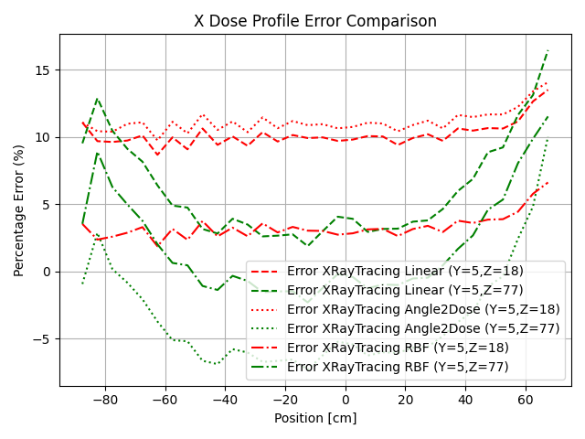
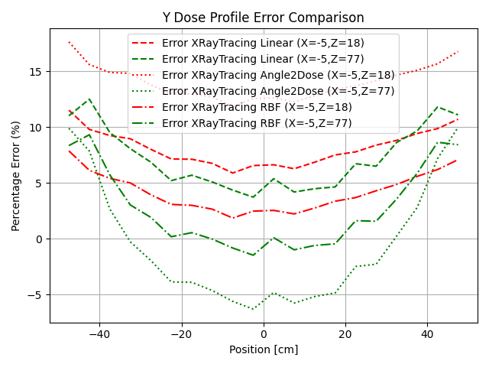
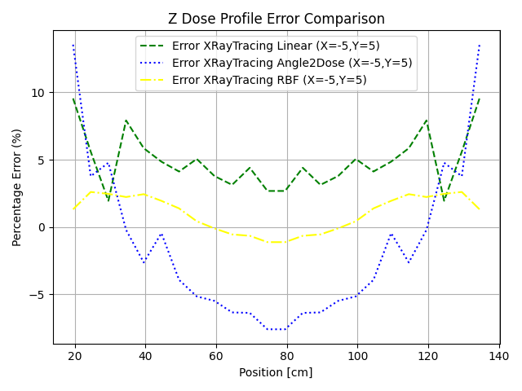
Results Double Side
XRayTracing Double Side Results on Citrus_V03 set up for different methods
Comparison dose relative errors between methods and RayXpert simulated data
Clearly RBF has almost all errors bounded by 12% (mostly under 5% in absolute)
Angle2Dose method commits the worst errors above 18% in Y profile
Linear method performances are between RBF and Dose2Angle

Slide 24
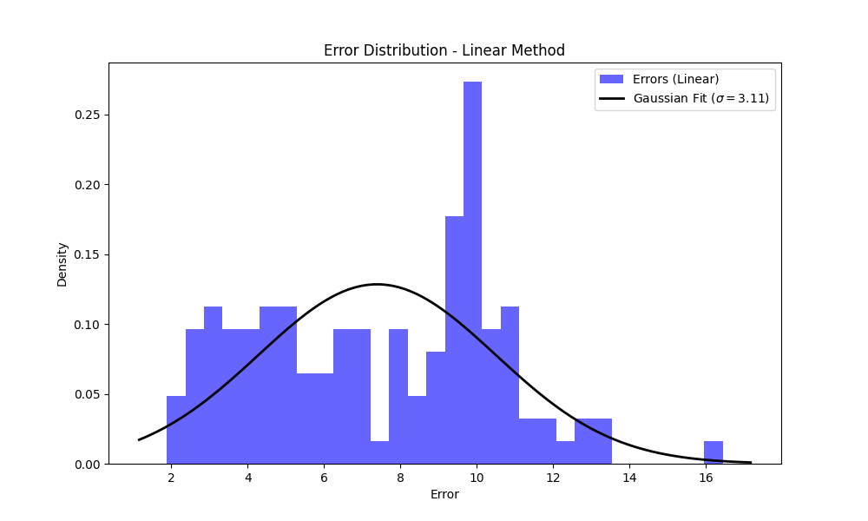
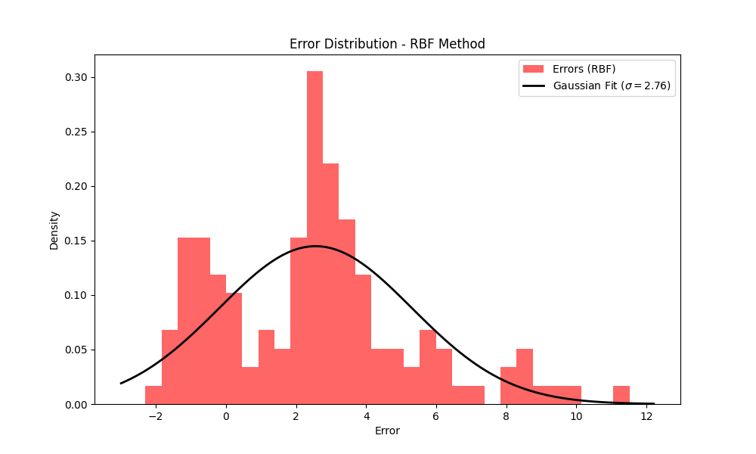
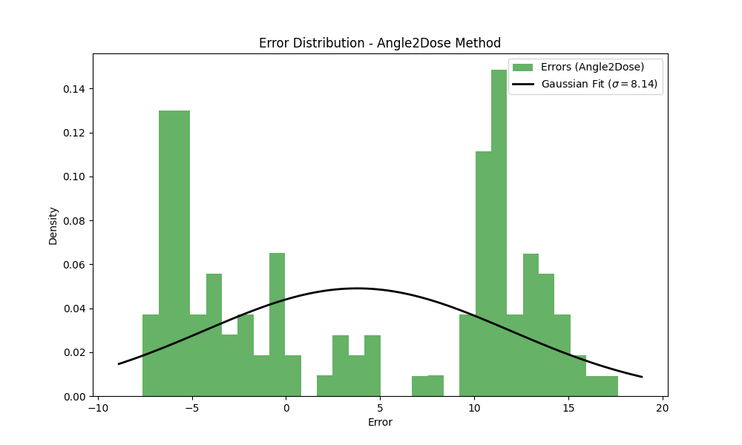
Results Double Side
XRayTracing Double Side Results on Citrus_V03 set up for different methods
Comparison dose relative errors distributions (by aggregating all errors)
RBF has the shortest distribution variance while Linear method has the largest one
Linear and RBF mostly overestimate the dose
Angle2Dose really over and underestimate but rarely get the correct dose

Slide 25
Table of content
Context & objective
Method
Results
How to create new kernels?
References

Slide 26
How to create new kernels ?
RBF and Linear methods can be extended to new sources (energy, spectrum, …)
Each method has a corresponding python script in ‘XRayTracing_Kernel_Creation’ directory for computing and visualizing results
New Creation Process :
Conversion e-γ and creation of a particle storage file for the given new source
Creation of a spherical shell with torus dosimeters in a .rxt file with Script4_tore.py
Creation of source in that .rxt file using particle filter
Monte Carlo Simulation of .rxt file (by default kerma water)
Use 'Kernel_Creation_Linear_Method.py' or 'Kernel_Creation_RBF_Method.py' on simulation .dat file, both in ‘XRayTracing_Kernel_Creation’ directory
Save the output files for both methods and add them to ‘./Methods_data/’ in XRayTracing
If new energy created (example 5MeV), slightly adapt ‘compute_dose()’ function and ‘Energy_list’ list to XRayTracing python code in order for the script to use the new kernel energies.

Slide 27
Table of content
Context & objective
Method
Results
How to create new kernels?
References

Slide 28
References
D. Prieels & G. Fontaine, “XRayTracing – Modus Operandi”, M-ID 128381
D. Prieels, “X-ray source definition”, Y22M05D20 – X-ray Source Definition_V2.pptx

Slide 29
Damien Prieels, Product Manager @ IBA Industrial

